Slide 1
Radio Lollipop’s Statement of Corporate Purpose
Volunteers providing care, comfort, play and entertainment for sick children in hospital
Notes:
Say: Welcome to a unique charity whose volunteers are key to its success.
Say: Radio Lollipop is a charity where the volunteers actually deliver the service directly to its target beneficiaries. We don’t just raise money for a good cause, although we do that as well.
Say: It is the time we donate to spend those really special times with the sick children on the wards, which delivers exactly what Radio Lollipop is about.
Say: It’s great to see you’ve already shown so much dedication to becoming a volunteer especially during your wait between, application, interview, blue card check and today your induction day.

Slide 2

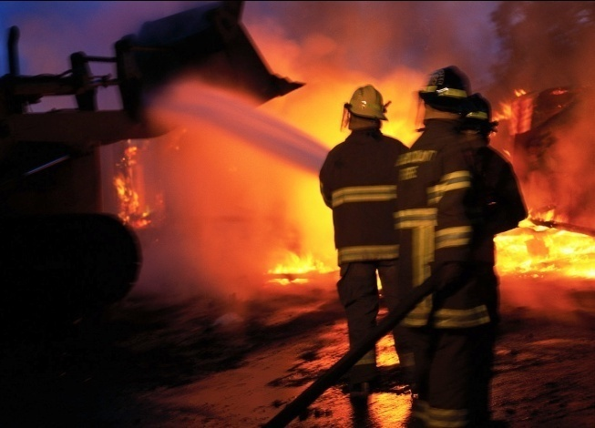


Housekeeping
Notes:
For Session 1 you will need:
You in full Radio Lollipop Uniform
Do’ and Don’ts handout on A4 paper for syndicate exercise
Flipchart for syndicate exercise (In the Tube)
Marker pens (from Play Cupboard)
Radio Lollipop Uniform list to complete for each volunteer, on signing in sheet
Signing in sheet
Play baskets x 7
Play planning sheet
Activity record sheets
Water for delegates
Paper cups
Name cards
Volunteer Handbooks
Contact details for the management team

Slide 3
Induction Programme
Welcome and Introductions
History of Radio Lollipop
Structure of Radio Lollipop
Safety
Radio Lollipop Routines
Management Team Roles
Play and Radio

Slide 4
Introductions…
Introduce yourself to the person next to you.
Find out:
Their name
What they do outside Radio Lollipop?
Why they joined Radio Lollipop?
Then introduce your partner to the rest of the team.

Slide 5
A Brief History of Radio Lollipop
Born in 1978, Queen Mary’s Hospital for Children in Carshalton.
Notes:
10:50
Say: As above on the slide.

Slide 6
Message from Hedley in film to be inserted here.

Slide 7
A Brief History of Radio Lollipop
Born in 1978, Queen Mary’s Hospital for Children in Carshalton.
5th May 1979, first Radio Lollipop went live.
1985 International expansion to Perth in Western Australia – Princess Margaret Hospital for Children.
It has grown from strength to strength with the hard work of all its volunteers.
Notes:
10:50
Say: As above on the slide.

Slide 8
Radio Lollipop’s Statement of Corporate Purpose
Volunteers providing care, comfort, play and entertainment for children & young people

Slide 9
The Structure of Radio Lollipop

Slide 10

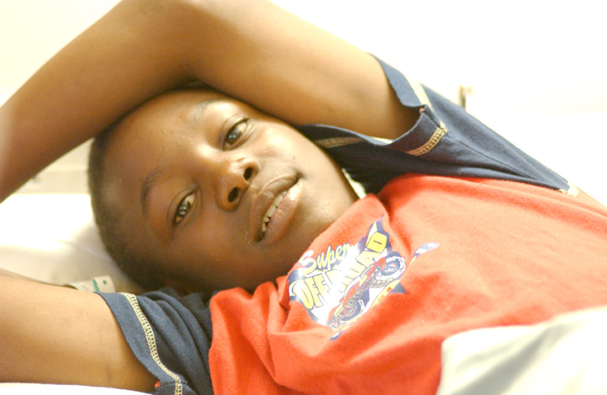
Making a Difference
Notes:
Show Video

Slide 11
Radio Lollipop Station Management Team
Honorary Chairperson
Honorary Vice Chairperson
Honorary Secretary
Honorary Treasurer
Honorary Play Co-Ordinator
Honorary Programme Co-Ordinator
Honorary Volunteer Co-Ordinator
Honorary Fundraiser
Honorary Engineer
Honorary Press & PR Co-Ordinator

Slide 12
National Support Team/Project Managers
Denise Norman PR &
Marketing
George Williamson Webmaster
Dave Mason Engineering

Slide 13
Radio Lollipop (UK) Board of Directors
Hedley Finn MBE – Chairman
John Hughes
Graham Elderfield
Sandy Gillett
Mark Maffey
Sally Prescott
Isabel McCallum
George Williamson
Andy Gray
Aidan Thompson
Derek Overton
John Dash

Slide 14
Radio Lollipop (International)
International President Hedley Finn
International Chairman Bruce Uhlhorn
Company Secretary John Hughes
Radio Lollipop UK John Hughes
Radio Lollipop USA Donna Huck
Radio Lollipop New Zealand
Radio Lollipop Australia Bruce Uhlhorn

Slide 15
Registered Office
6 New Street
London
EC4A 3LX
Notes:
10:35
Hedley Finn MBE – President and Chairman (UK)
John Hughes – Company Secretary
John Hemmings - Accountant

Slide 16
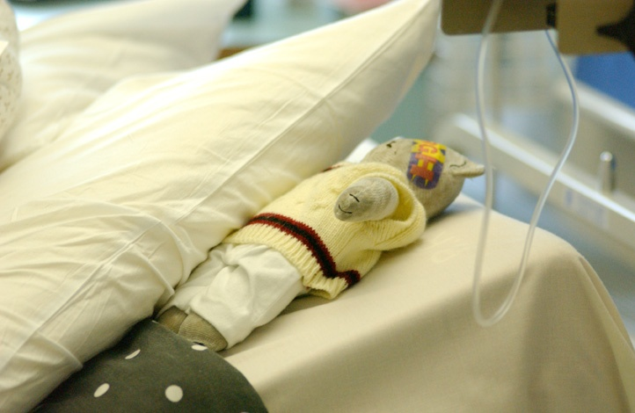
Radio Lollipop and Hospitals
A partnership
SAFETY

Slide 17
Exercise
In two groups...
Group 1
Consider:
What are the benefits to the children, siblings, parents
and hospital staff of having Radio Lollipop in their
hospital?
Group 2
Consider:
What are the risks of having Radio Lollipop to the
children siblings, parents and hospital staff?

Slide 18
Exercise
In three groups...
Group 1 – What do we need to do as volunteers to ensure that the children are safe when interacting with Radio Lollipop Volunteers?
Group 2 – What do we need to do as volunteers to ensure that Radio Lollipop’s reputation is safe (and maintained)?
Group 3 – What do we need to do to ensure as volunteers that we remain safe whilst on Radio Lollipop duties (and beyond)?

Slide 19
Safety for the Children
Confidentiality of patients is respected
A child's secret is taken by volunteers with conditions!
We don’t lift patients
We don’t give children any food or drink
We gain permission from the nursing staff and parents to take a child to the studio
We don’t take photographs of the children without the parents written consent
We don’t take the children to the toilet
We adhere to infection control guidelines in the hospital
Safe play
All volunteers are medically and safety (Criminal records) clearer

Slide 20
Safety for Radio Lollipop
The behaviour of any person wearing Radio Lollipop sweatshirts or T-Shirts are aligned to that specified in the Radio Lollipop Volunteer role description
The logo is not compromised
The logo or uniform represent ‘fun’ to the children ensure that this is maintained by all volunteers
Has reputation which needs to be maintained
Wear the correct uniform (as shown on the next slide)

Slide 21
Radio Lollipop Uniform
Radio Lollipop Polo T-Shirt or
Sweatshirt – Clean and pressed
Navy blue jeans, trousers or knee length skirt
White soft soled shoes
Radio Lollipop/Hospital identification badge

Slide 22
Safety for Us
Hand hygiene
Work in pairs
Don’t take children to the toilet
Be prepared to see situations we don’t get to see in every day life
We raise any concerns to Nursing staff, Volunteers, Team Leader, Management Team or Directors
Wear the correct footwear
Attend the required training
Adhere to infection control guidelines
Be prepared for the potential death of some children
Medical clearance

Slide 23

Toilet Visits
Are NOT your responsibility
Inform the Nurse

Slide 24
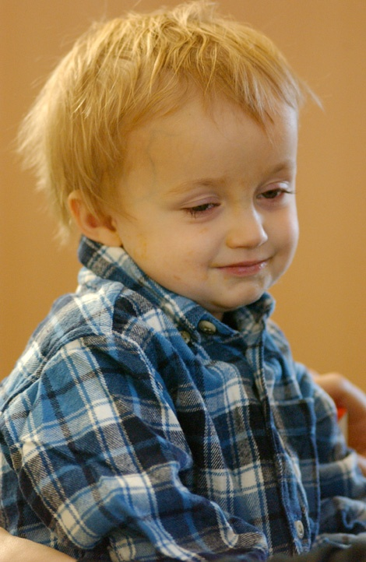
Dealing with terminally ill children

Slide 25
Do’s and Don’ts
Syndicate Exercise
From the list of Do’s and Don’ts, sort them into 2 piles “Do’s” and “Don’ts”
and think about why they exist as they do.

Slide 26
Questions….? And LUNCH…

Slide 27
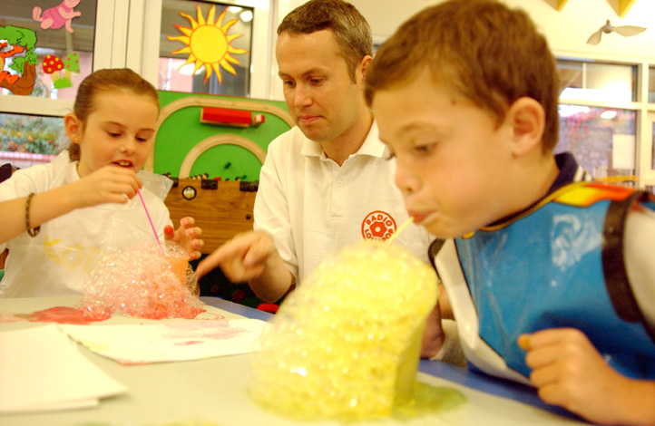
Hospital & Ward Routines

Slide 28

Timings
Arrive at the hospital at least 30 minutes before the start of the ward visiting hours which are:
Monday (Enter station timings)
Tuesday (Enter station timings)
Wednesday (Enter station timings)
Thursday (Enter station timings)
Friday (Enter station timings)
Saturday (Enter station timings)
Sunday (Enter station timings)

Slide 29
Exercise
In two groups...
Group 1
Consider:
What information do you believe that you would need before going
on to the wards for the evening?
How may this helps you and others i.e. The children, volunteers, the
presenter, the siblings, parents, nursing staff and Radio Lollipop?
Group 2
Consider:
After visiting the wards, what information do you believe that you
would want to share as part of the de-brief?
How may this helps you and others i.e. The children, volunteers, the
presenter, the siblings, parents, nursing staff and Radio Lollipop?

Slide 30
Briefing
All volunteers have signed in
Themes for the night, gain guidance on how to create the craft activity for the night
What phone in competition will be taking place and when
If there are any children to look out for i.e. Who maybe bored, sick or in need of extra attention
If there is anything to be concerned about i.e. Seriously sick child
Who is working with who
Who is going to work on which ward

Slide 31
De- Briefing
What went well, celebration and magical or wow moments
What didn’t go so well
Who they have worked with age, sex, child
Who received prizes
Capture data of the number of children, age and prizes for Radio Lollipop information
Any concerns i.e. Sick children
Who the next Radio Lollipop volunteer may need to look out for
What could have be done differently to improve the service
All volunteers sign out

Slide 32
Routines
Weekly
Nightly briefs and debriefs
Monthly
Management Team Meetings
New Volunteer Skills Training
Quarterly
National Reporting
Volunteer Meeting
Directors Meeting
Annual
Training Weekend
Chair & Directors Meeting

Slide 33
Chairperson
Key responsibilities:
Leadership
Maintaining Standards
Progress of the station
Policies and procedures are followed
Quarterly/Annual reporting

Slide 34
Honorary Secretary
Key responsibilities:
Ensure clear communication is maintained for the station and outside the station
Monitoring of mail
Compilation and issue of minutes
Prepare reports

Slide 35
Post holders Roles & Responsibilities
In groups of three or four, take a look at each
Post holders job description.
Detail on the flipchart the following, for each post:
The purpose of the post
The key responsibilities of each post

Slide 36
Radio Lollipop Management Team STATION NAME
Honorary Chairperson (Name)
Honorary Secretary (Name)
Honorary Treasurer (Name)
Honorary Play Co-ordinator (Name)
Honorary Programme Co-ordinator (Name)
Honorary Volunteer Co-ordinator (Name)
Honorary Fundraiser (Name)
Honorary Press & PR Co-ordinator (Name)
Honorary Engineer (Name)
Notes:
Say: Here is the Management Team here at Mater and Logan.
Say: The Chairperson reports to the local Trustee for the station. The chairperson attends two key meetings each year with the Trustees.
Say: Let’s take a look at each post within the management team, to gain an understanding of their role and the part it plays in the smooth running of Radio Lollipop.

Slide 37
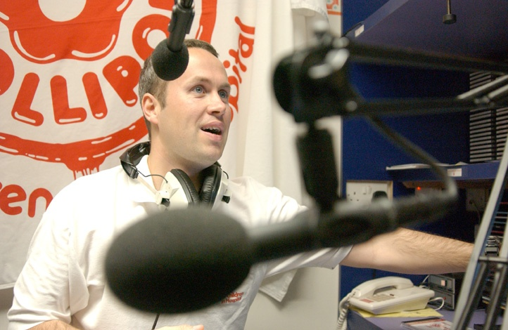
The Magic of Radio & Play

Slide 38
Exercise
In groups create a theme for use on the wards, the following
things need to be considered:
Activities to suit the following age groups (boys and girls)
0-5 years
6-11 years
12+ years
Music to be played to support the theme
2 phone in competitions
What prizes maybe aligned to the theme
You have 30 minutes to come up with your theme and to
present to the rest of the group.

Slide 39
Questions….?

Slide 40
Thank you and See you soon

